Slide 1
Sparks parks and recreation department
Presentation by:
Andrea Tavener, Sparks Parks and Recreation Commission Chair
Tracy Domingues, Parks and Recreation Director

Slide 2
PARKS AND RECREATION FY19 BUDGET AT A GLANCE (FUND 1221- AS OF 7/23/19)
FY19 | Budget | Actuals | Difference
Expenses | $4,256,083 | $4,034,912 | $221,171 under
Revenues | $2,818,555 | $3,034,244 | $215,689 over
Difference | ($1,437,528) = 66% Cost Recovery | ($1,000,668) = 75% Cost Recovery

Slide 3
Parks and recreation FY19 revenue breakdown (Fund 1221)
Aquatics/Alf Sorensen Comm. Center $256,895
Adult Sports $305,391
Special Events $300,542
Youthwatch $1,965,058
Marketing/Rentals/Misc $206,358

Slide 4
Parks and recreation Accomplishments in FY19
Recreation, Administration & Events had a 75% cost recovery rate;
Golden Eagle had a $24.4 million economic impact to the Truckee Meadows;
15th Annual Mayor’s Cup Golf Tournament raised $15,000 for the Youth Scholarship Fund – the highest contribution to date.

Slide 5
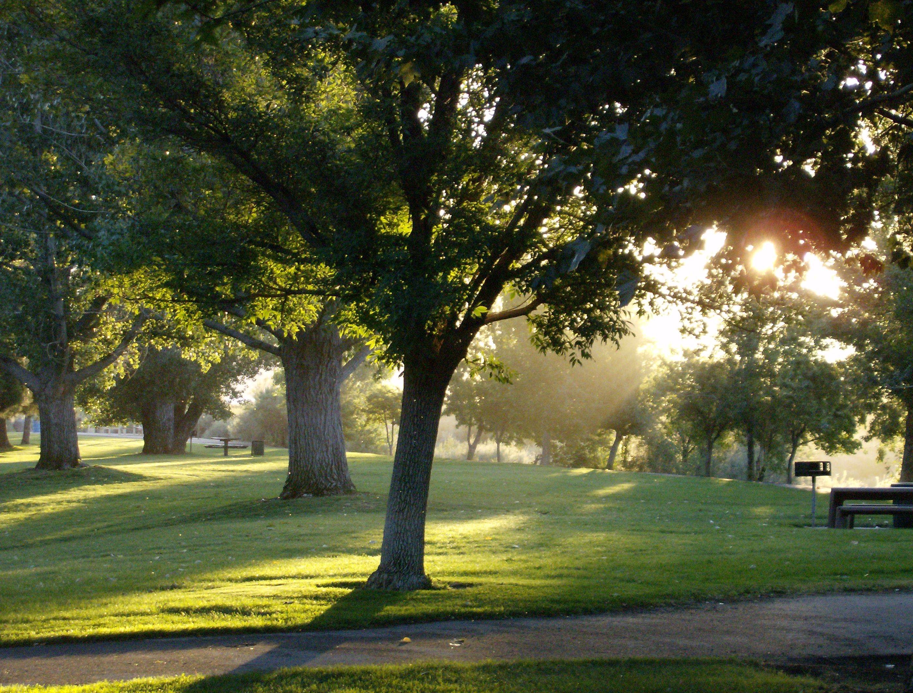
Parks and recreation Accomplishments IN fy19
Reinstatement of Park Naming Sub-Committee
Named 2 future parks;
Passage of smoke/vape free parks in Sparks (June 2018), Reno and Washoe County;

Slide 6
Parks and recreation Accomplishments IN FY19
Received $50,000 grant from National Endowment for the Arts for public arts overlay plan for Victorian Square;
New events: Lantern Festival, Tweed Ride and Tintabulations Concert.

Slide 7
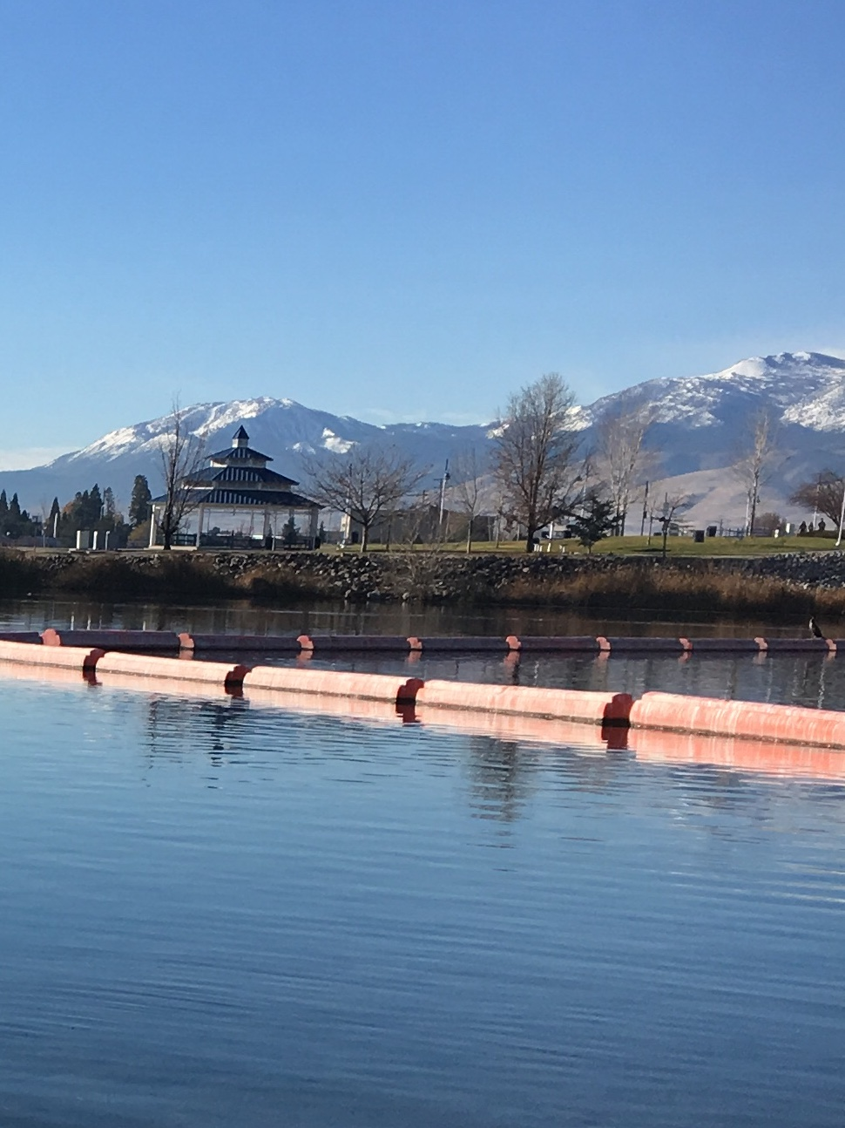
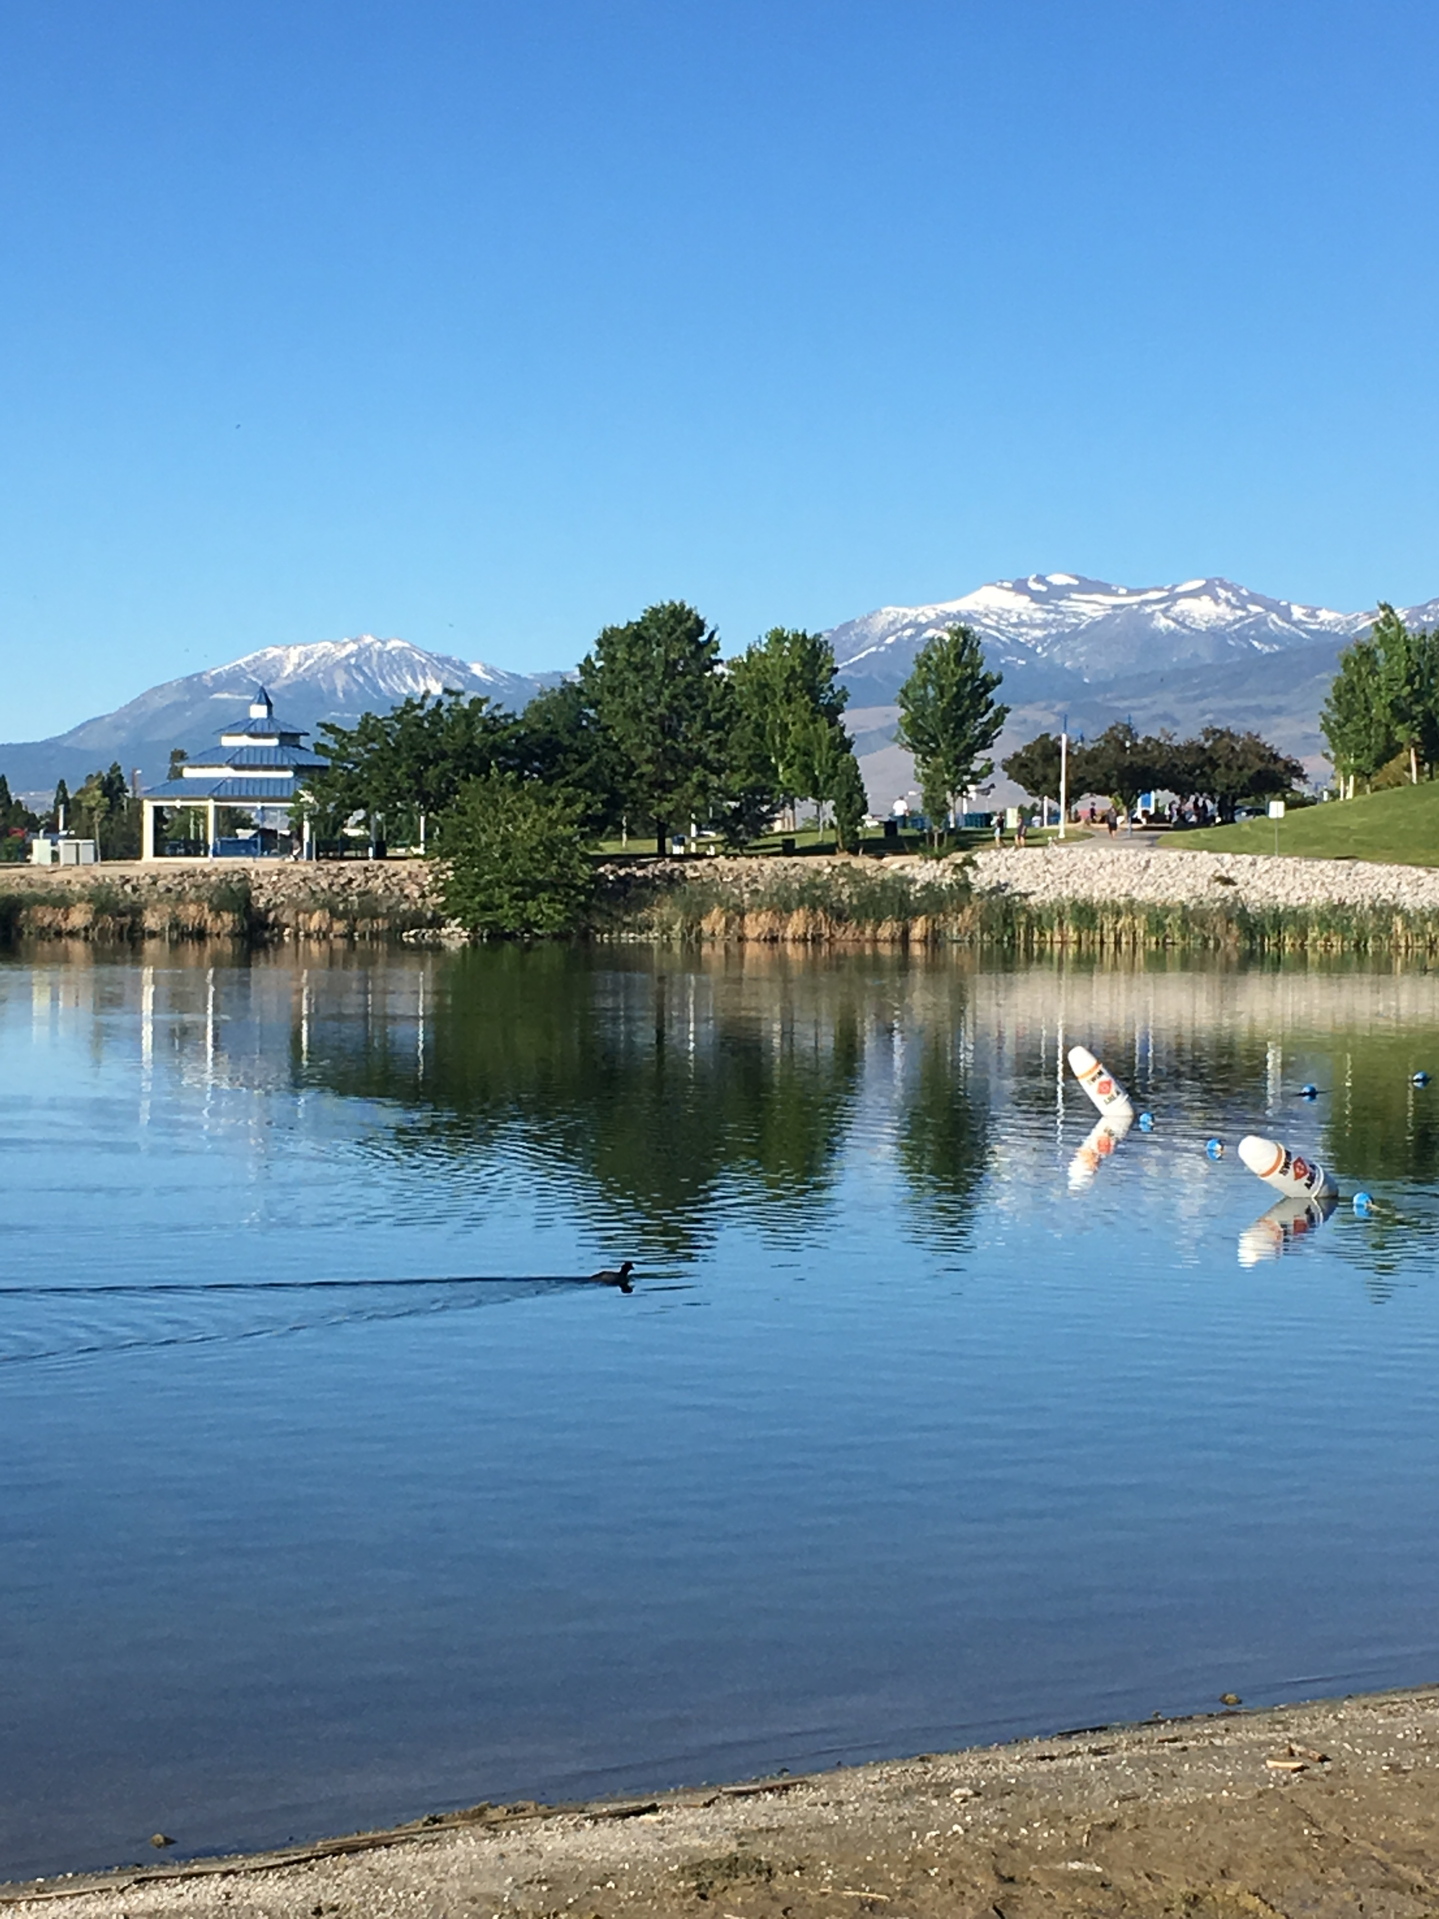
Sparks Marina Park Improvements
Designated swimming area:
Reduced in size;
Logs replaced with life line rope and vertical buoys providing less opportunity for birds to perch; and
Sand (400 tons, $24,500).
Positive feedback from park users.

Slide 8
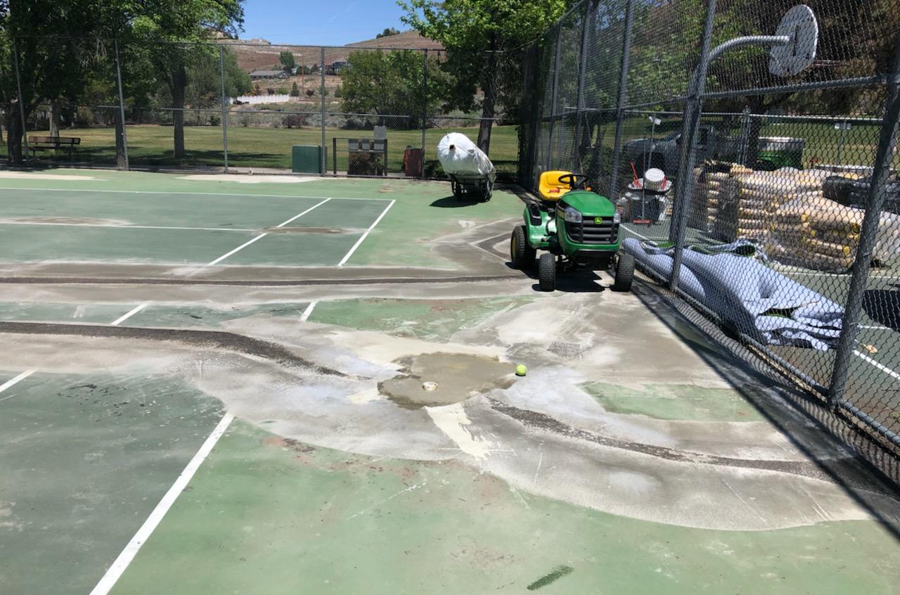
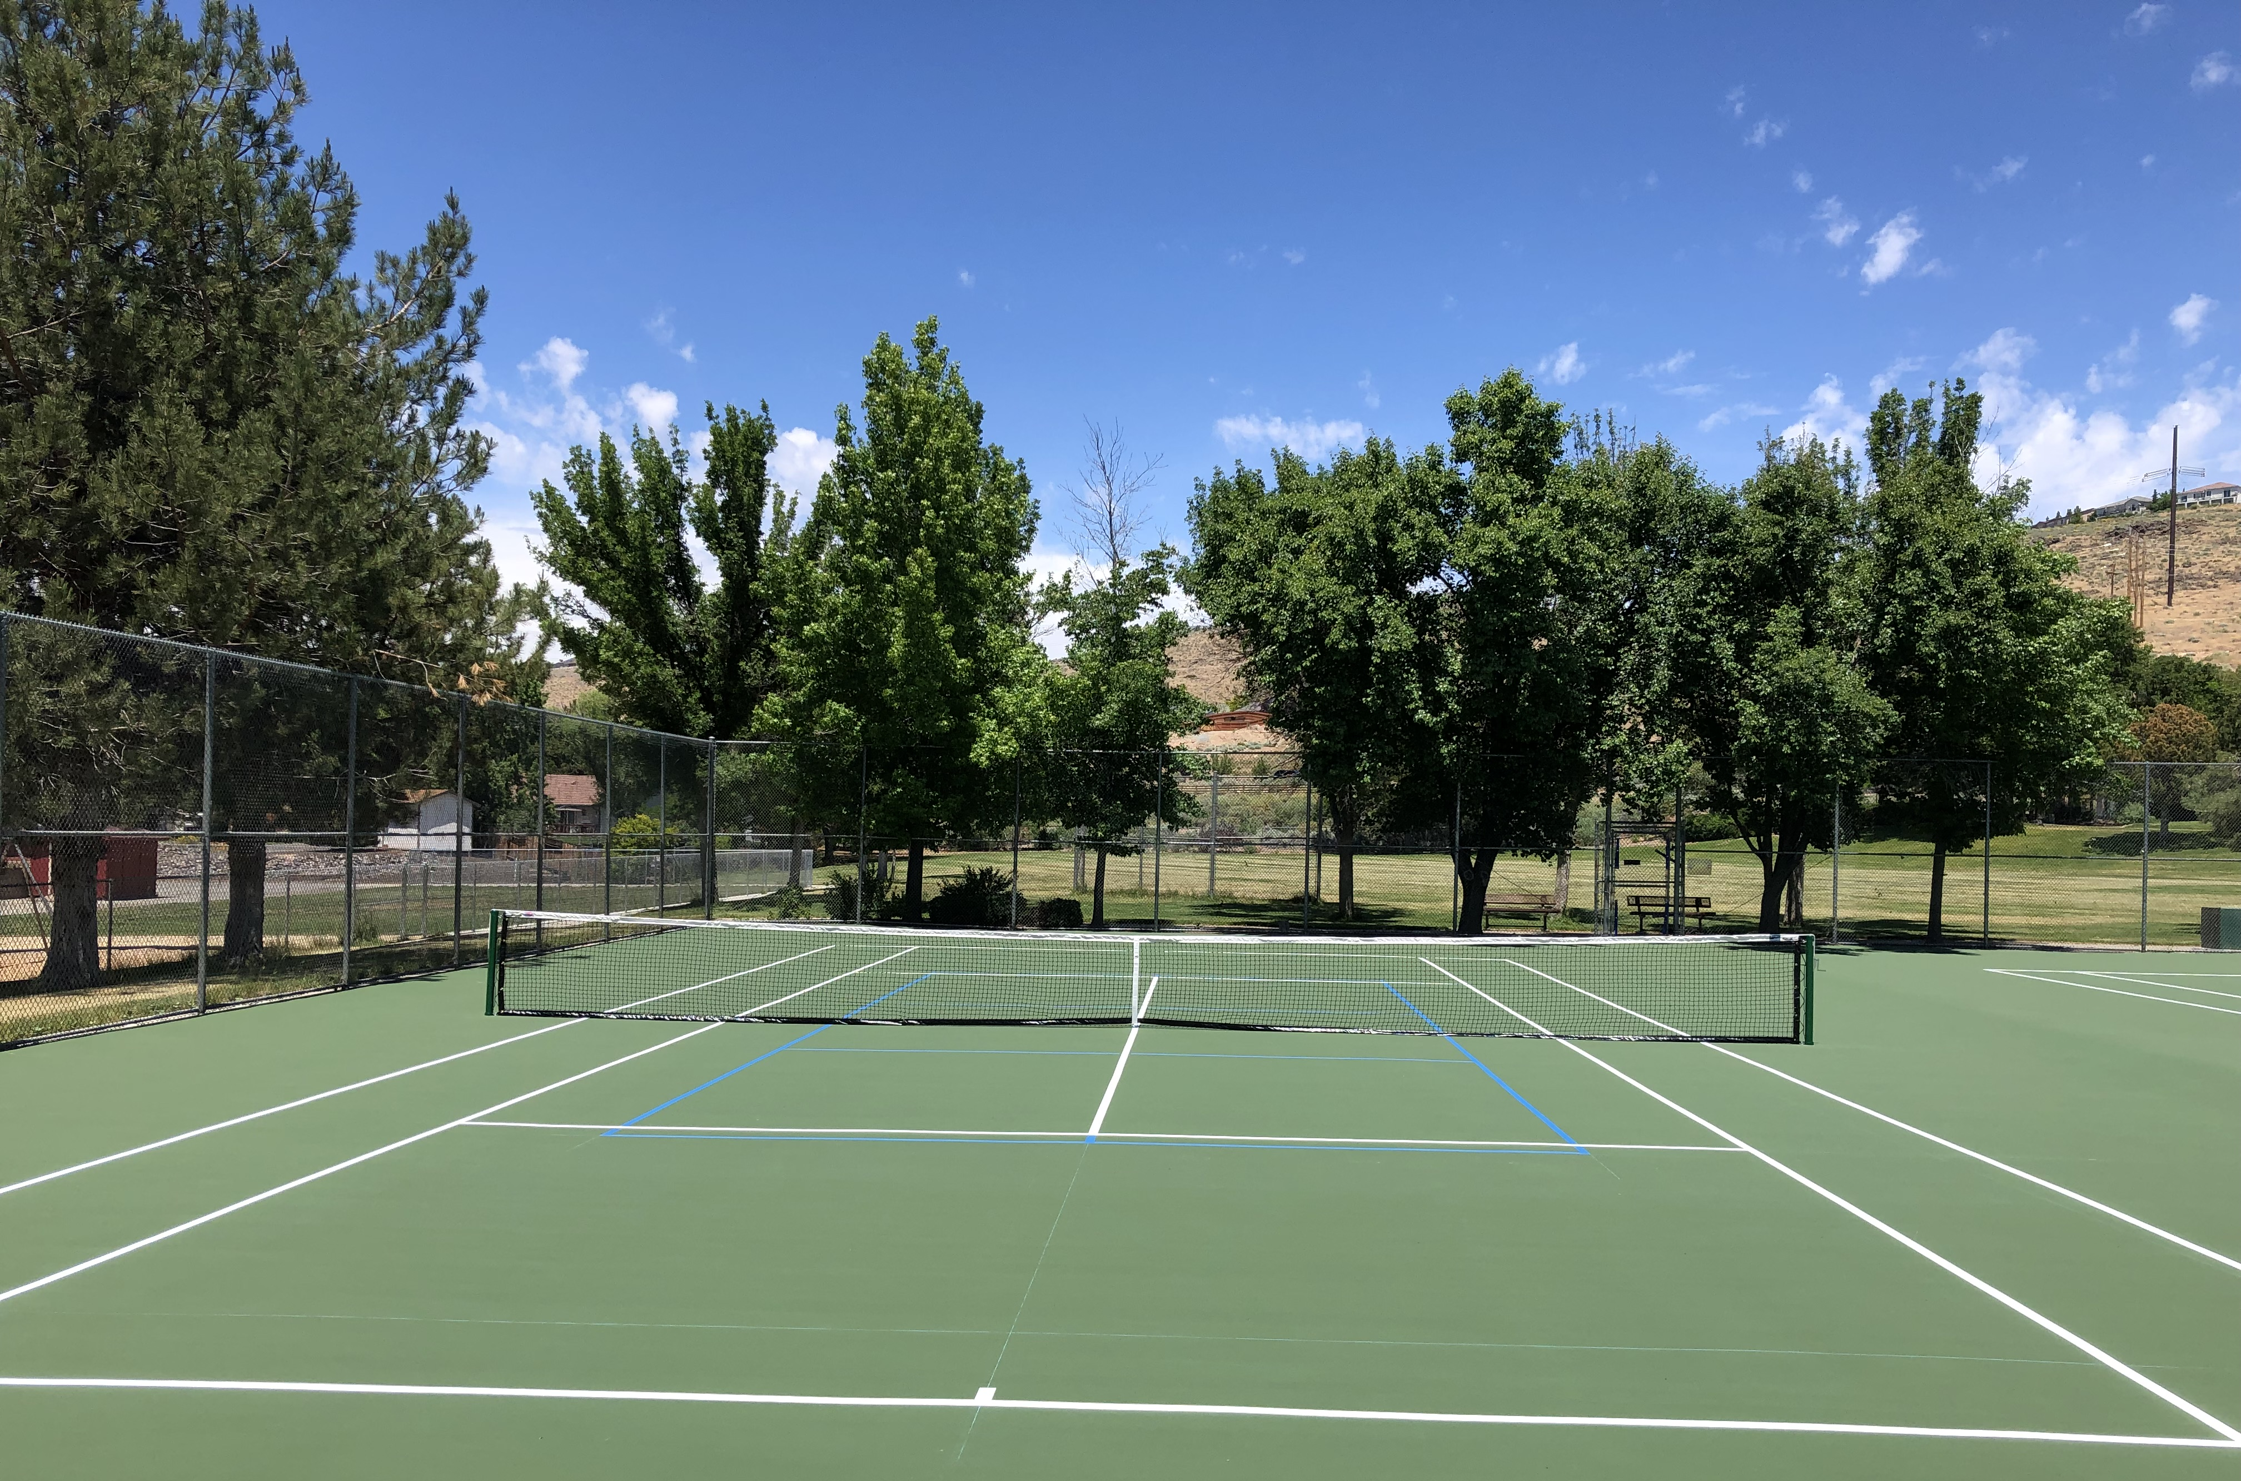
PAH RAH TENNIS COURT RESURFACING Courts reopened June 13th
PROBOUNCE TENNIS COURT SYSTEM
Cost $107,829 ($7.49 per sq ft);
Synthetic fibers with sand infill and polyseal resin binder;
Floats on top of existing asphalt surface; and
Future cracks in the asphalt won’t reflect through the PROBOUNCE surface.

Slide 9
Parks and recreation challenges
Difficult to recruit, train and retain staff to meet program demand. As a result, enrollments are capped and wait lists are maintained;
Inability to serve the increase in population due to limited resources, staff and facilities.
Park Maintenance utilizes contract labor & Sheriff’s work crews to maintain the park system. Without the extra help, the work simply could not get done with staff alone.
Two new parks to be built in FY20 with more on the way.

Slide 10
Partners in parks and recreation
Adopt-a-Park Program:
68% of our parks are adopted by residents and businesses;
Partners pick up garbage, report graffiti, clean planters and much more;
Each group receives a sign of recognition in their park.

Slide 11
Partners in parks and recreation
Eagle Scout projects improve the park system by:
Staining wooden playgrounds;
Rehabilitating horseshoe pits and more.

Slide 12
Partners in parks and recreation
Various businesses support the Parks and Recreation Department through advertising and marketing efforts;
Local foundations provide grant funding;
Volunteers on boards and committees are great advocates; and
Every partner is acknowledged in the bi-annual Parks and Recreation Activity Guide and each July in the Reno Gazette Journal.

Slide 13
TREE PLANTING AT SHADOW MOUNTAIN sports complex
Rotary Club of Sparks
Rotary Club of Sparks Centennial Sunrise
Replaced 45 trees, most of which were killed by the Western Bark Beatle

Slide 14
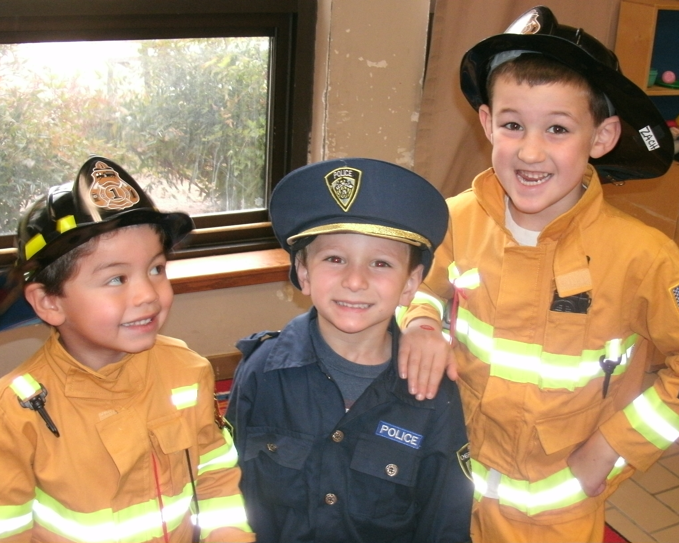
THANK YOU FOR YOUR CONTINUED SUPPORT
QUESTIONS?

